Slide 1
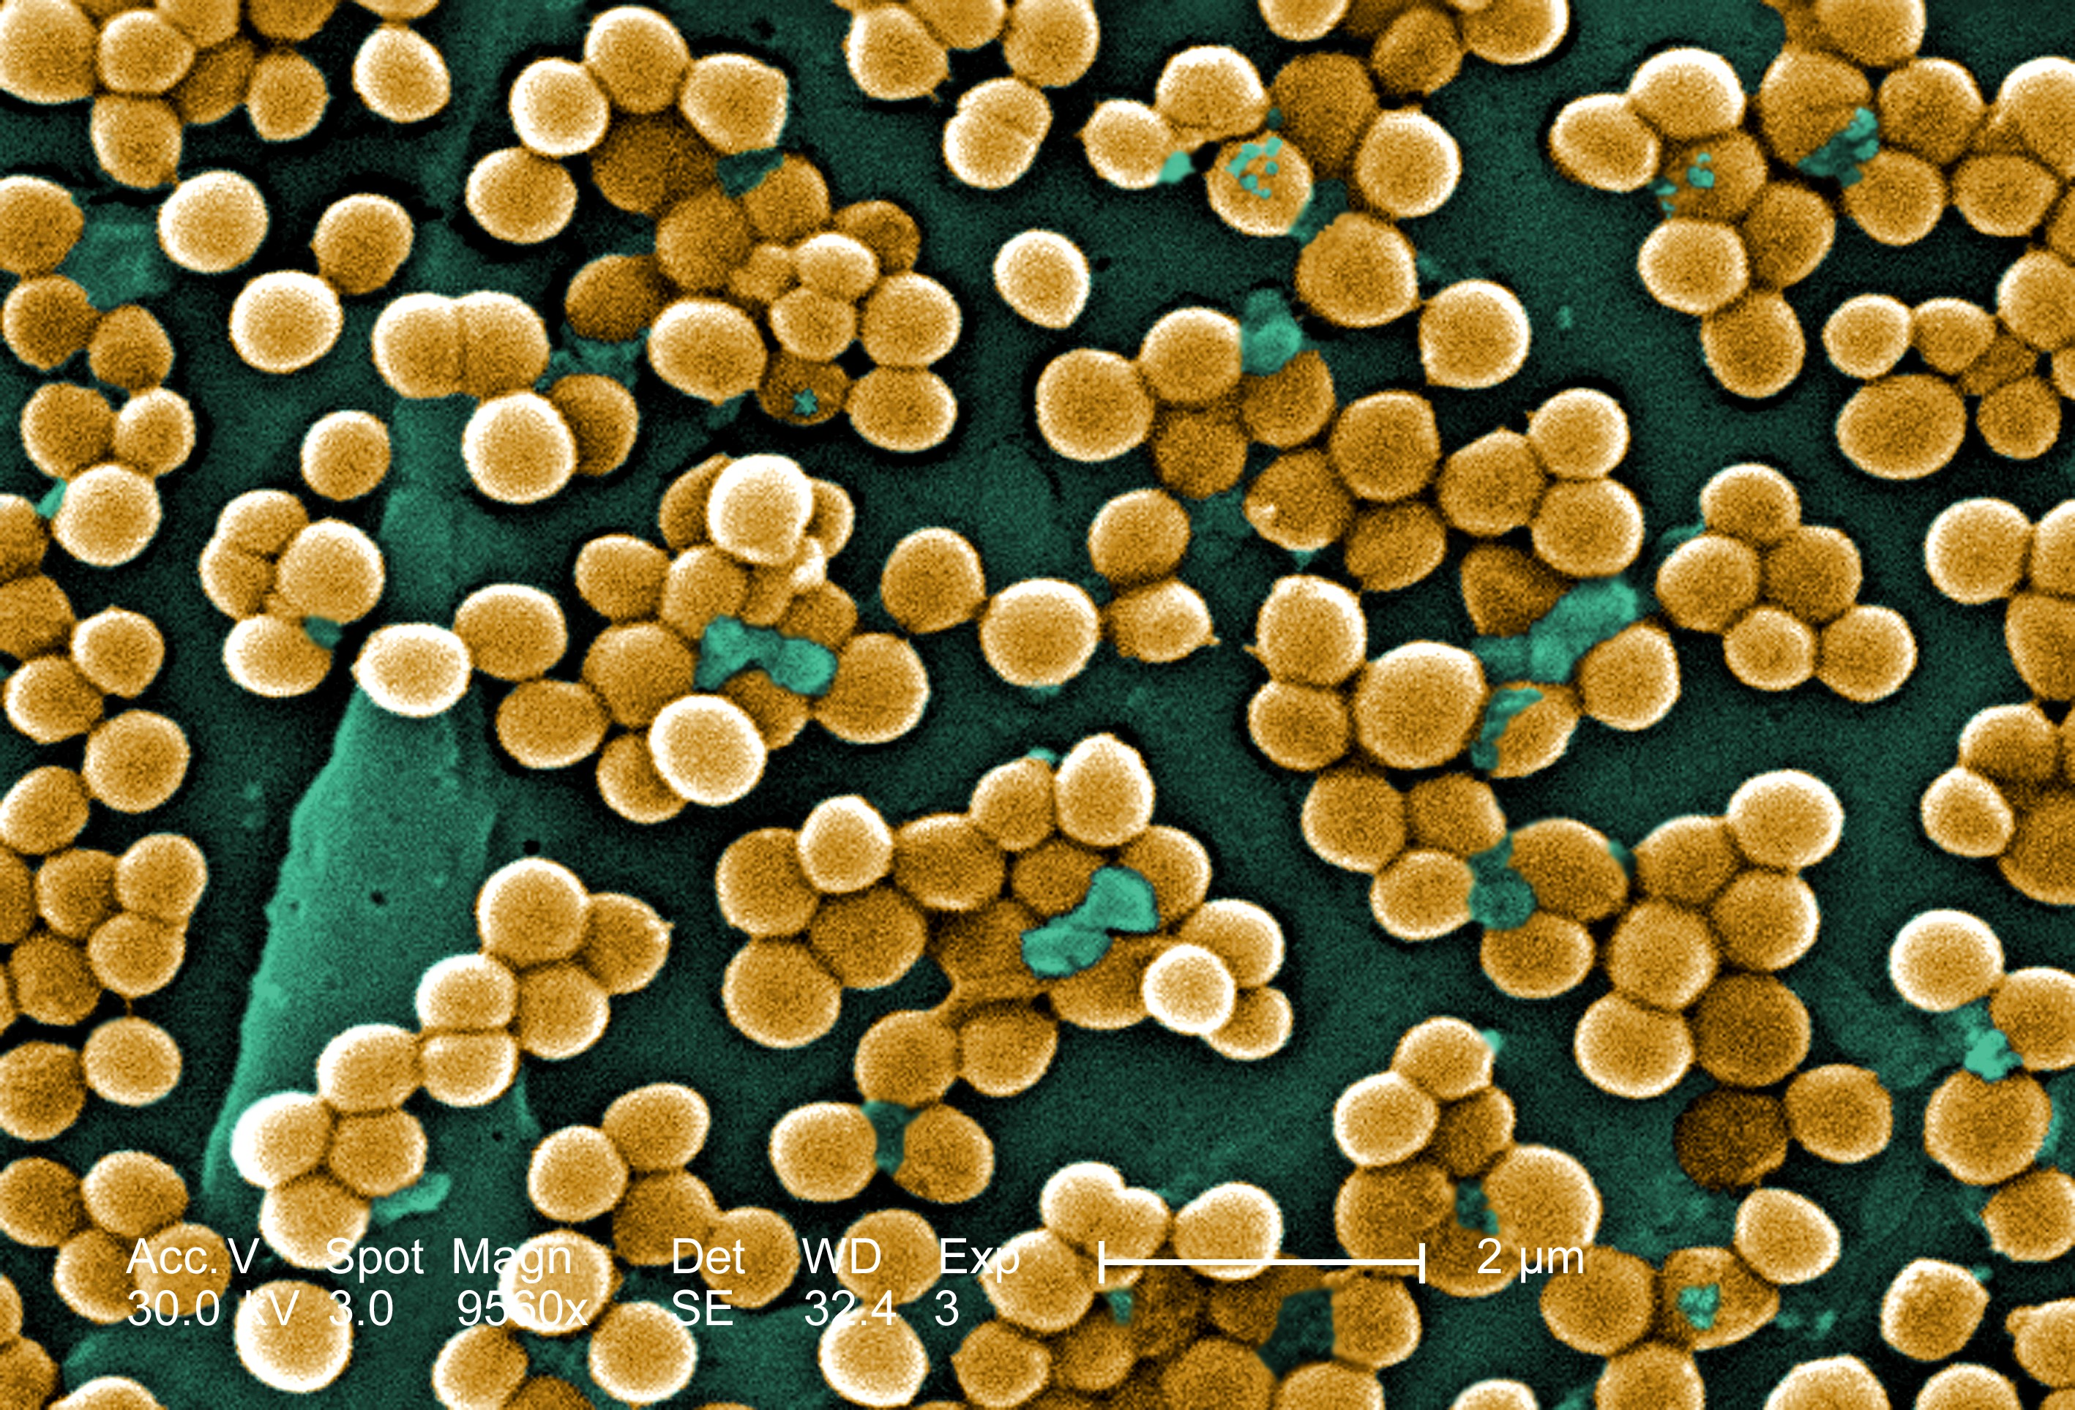


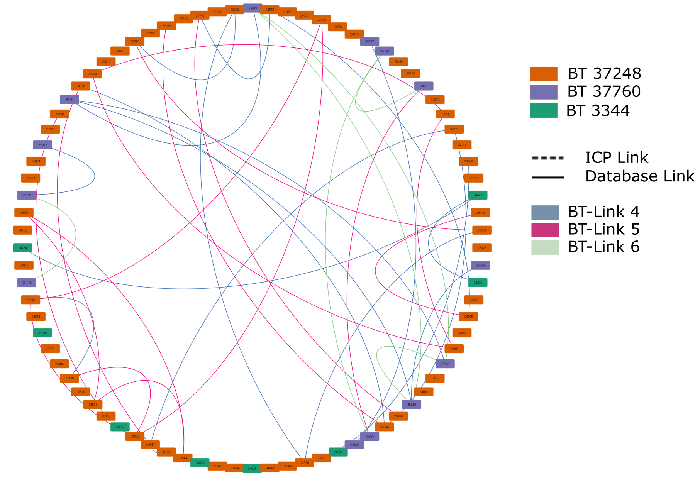
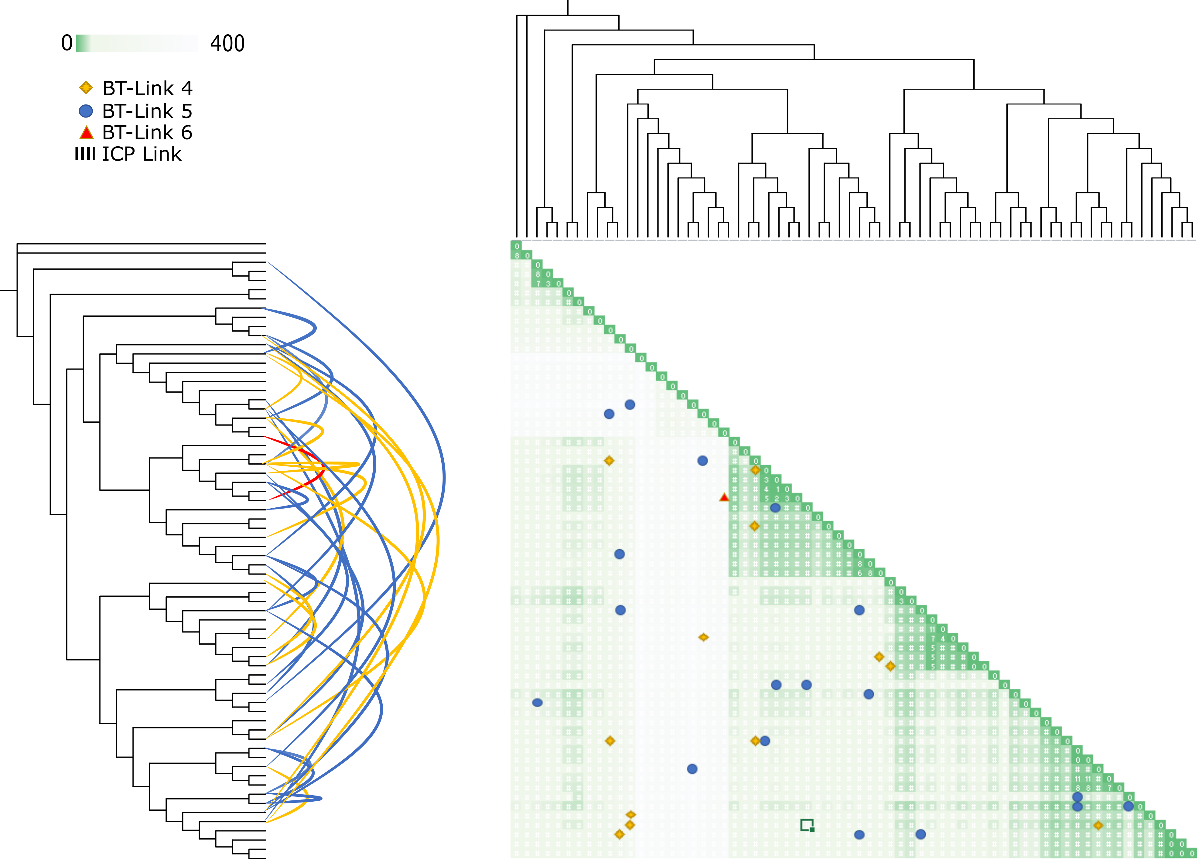
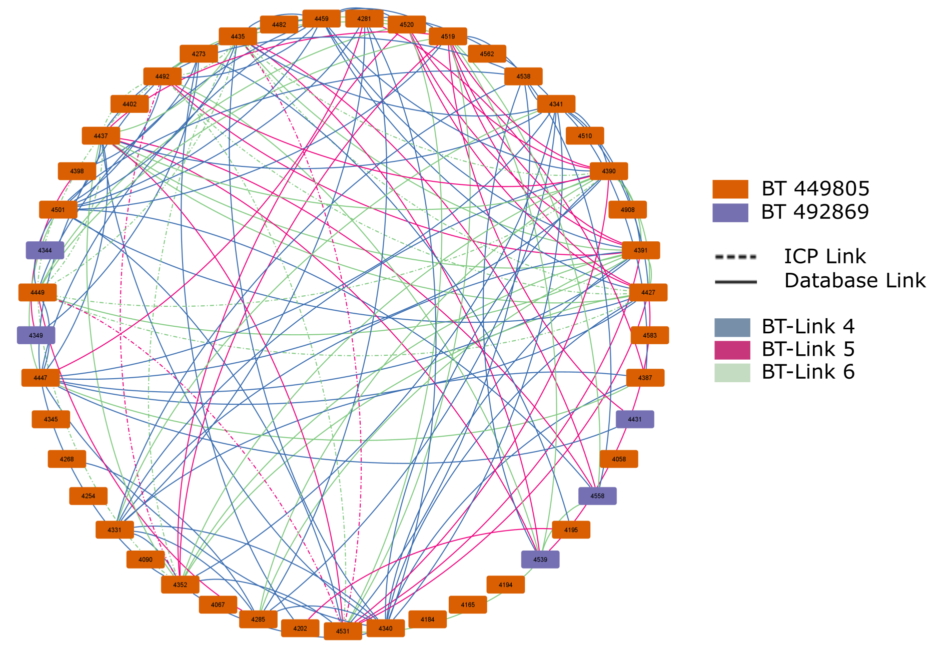
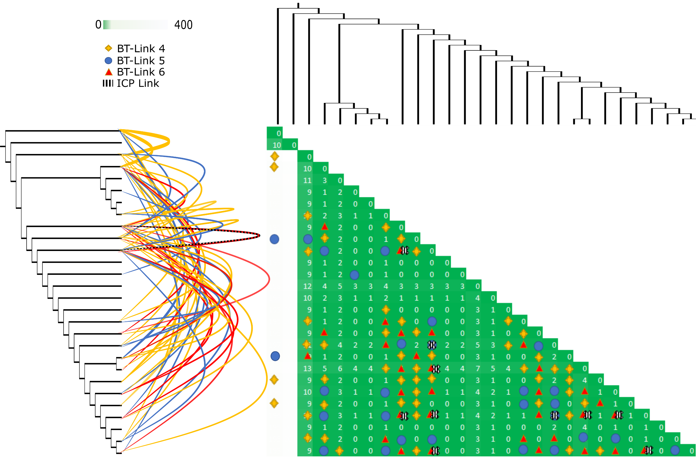
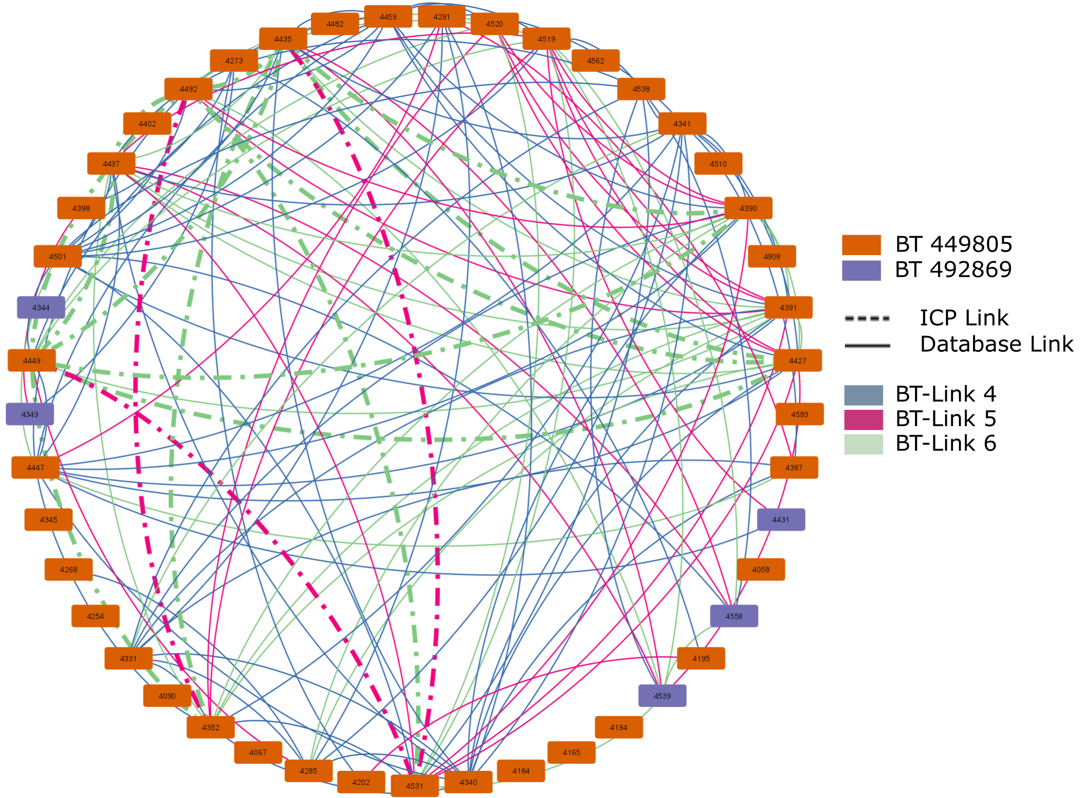

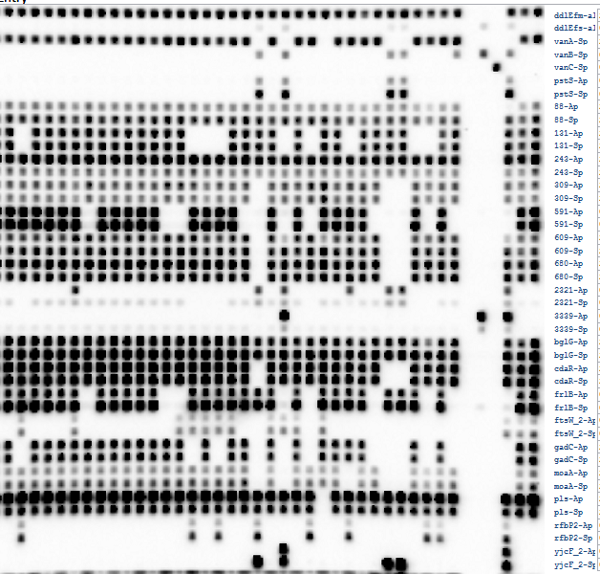
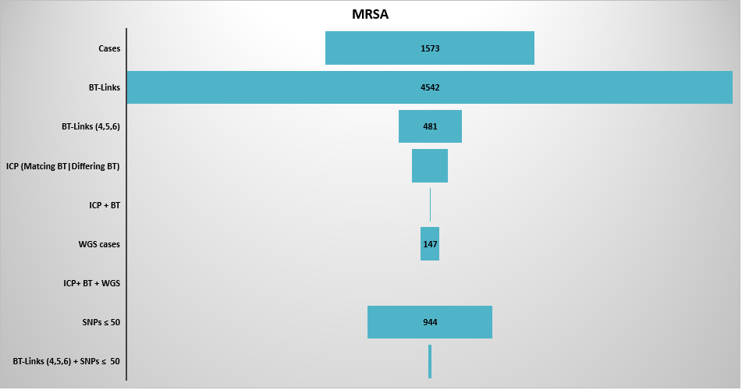
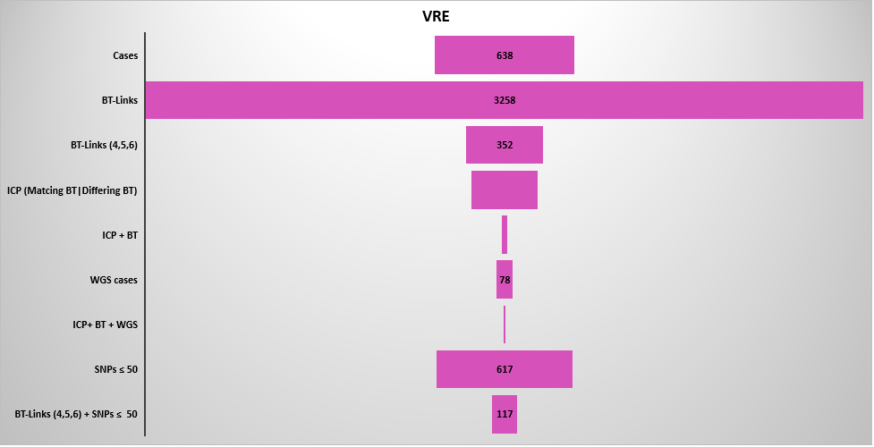
Rapid prospective strain typing to identify unsuspected nosocomial transmission of MRSA and VRE
Jessica Johnson-Mackinnon^{1,2,6}, Marc Ramsperger¹, Cecilia Li^{1,2}, Marion Yuen¹, Vijay Errappa³, Miechelline Magallanes³, Kathryn O’Donnell³, Jennifer Sealy³, Nicole Tolhurst⁴, Elizabeth White³, Kathy Dempsey⁵, Patricia Ferguson^{1,3,6}, Adrian Ong^{4,6}, Vitali Sintchenko^{1,2,6} and Matthew O’Sullivan^{1,2,6}
¹Centre For Infectious Disease and Microbiology – Public Health, Westmead Hospital, ²New South Wales Health Pathology, ³Infection Prevention and Control Department, Westmead Hospital, ⁴Infection Prevention and Control Department, Blacktown Hospital, ⁵Clinical Excellence Commission, New South Wales Health and ⁶University of Sydney, Sydney, New South Wales, Australia
Background and Aims
Genotyping can reliably identify transmission of nosocomial pathogens but is rarely available in an actionable timeframe to assist infection control interventions. MRSA and VRE binary typing systems were applied to isolates from two referral hospitals (Westmead and Blacktown) over a period from March 2019 to November 2020. Binary type links (BT-Links) were predicted between isolates based on matching binary types, binary type frequency, patient proximity and temporal separation. These links were compared to the predictive links reported by Infectious Diseases Practitioners (ICP) in order to establish the assays effectiveness in 1) determining the validity of ICP identified nosocomial transmission and 2) identify unsuspected transmission events.
Methods
Results
Multiplex PCR and reverse line blot probe hybridisation (mPCR/RLB) assays designed for methicillin-resistant Staphylococcus aureus (MRSA)¹ and vancomycin-resistant Enterococcus faecium (VRE) each with 19 discriminatory targets. BT-Links were scored on scale of increasing probability from 1 - 6. Only link scores of 4 - 6 were considered significant. The number of suspected nosocomial transmission events (links) detected was determined by: BT-links, ICP-links and combination (BT+ICP-links). Whole Genome Sequencing was used on a subset of isolates with significant BT-Links including BT+ICP Links isolates to confirm accuracy of BT-Links.
A total of 4542 MRSA links and 3258 VRE links were identified (Figures 3) of those 481 and 352 respectively were considered significant. This was a noteworthy difference compared to ICP reported links. 18 MRSA-ICP-links with matching BTs were identified, only 6 corresponded with BT-Links. 44 VRE-ICP-links with matching BTs were identified, 31 of those corresponded with BT-links.
Figure 3. Analysis of a) MRSA and b)VRE cases to detect links by ICP review alone, by BT-links alone, and by both methods combined. Compared with WGS subset.
The sequenced subsets of 147 MRSA and 78 VRE each comprised of three main Sequence Types (ST) 30, 45 and 22 for MRSA and 769, 78 and 142 for VRE. For this study we set a threshold of ≤50 SNPs apart as the threshold for credible WGS link. For MRSA there were a possible 944 WGS-Links ≤50 SNPs, however only 30 significant BT-Links were confirmed (3.2%). For VRE there were a possible 617 WGS-Links and a confirmed 117 BT-Links (18.9%). Each Sequence Type had different SNP profiles. Two representative Sequence types have been chosen for this poster. 30 for MRSA and 769 for VRE. Overall, MRSA was more genetically diverse with ST 30’s SNP profile of: min = 0, max = 440, median = 57 and average =126, compared to min = 0, max = 208, median = 1 and average =27 for VRE ST 796 (figure 4).
Figure 4. 1&2 a) Network diagrams of BT-Links and ICP Links for representative WGS derived Sequence Types 30 and 796 (MRSA and VRE respectively). Each sequence type is comprised of several binary types denoted by coloured nodes around the edge. Each BT-score is coloured blue = 4, pink = 5 and green =6 with ICP-links denoted by dotted lines (BT-Link = corresponding colour, no BT-Link = black). 1&2 b) phylogenetic trees based on core genome alignments of MRSA and VRE sequences rooted at the earliest sample collected aligned with SNP matrix. The parabolas depict the connections of significant BT-Links across the tree. Colours depict score yellow =4, blue = 5, red = 6 and striped = ICP link, these scores are indicated on the SNP matric with corresponding shapes of the same colours, yellow diamond = 4, blue circle = 5, red triangle = 6 and striped X = ICP-Link. The SNPs are coloured in a scale of green 0 SNP apart to white 400 SNPs apart.
Suspected MRSA/VRE Case
ICP Epidemiological data Collection
Confirmed at Core Micro Via MALDI-TOF
Comparison with Database Links
RLB Binary Typing
Database Binary Type Linkage
WGS Data
BT-Link Networks
Core Genome SNP Alignment
Phylogenetics
SNP matrix
Analysis and Interpretation
BT Link with genomic Clustering overlay
a
b
a
b
18
255
44
273
6
31
0
11
30
1. MRSA ST 30 a)
1. b)
1. MRSA ST 30 a)
1. b)
Figure 1. Flow chart depicting the methods undertaken during this project. VRE/MRSA cases are suspected (ICP reported) and confirmed via MALDI-TOF. Once confirmed the isolates were entered into the database, they were run on RLB and their type was entered back into the database where BT-Links were calculated. A subset of MRSA and VRE were chosen and sequenced. These were core genome aligned to create phylogenetic tress and SNP matrixes between all isolates within a Sequence Type.
2. VRE ST796 a)
2. VRE ST796 a)
2. b)
2. b)
Isolates
Target probes
Figure 2. Sample mPCR/RLB binary typing result for VRE. The assay detects the presence of absence of 19 variable targets in the E. faecium genome, as well as vanA, vanB, vanC and species-specific controls. The resulting 19-digit binary string is converted to a decimal number for ease of comparison. A similar assay has been previously developed for MRSA¹.
Conclusion
Linked cases identified by ICP review correlated poorly with those identified by BT-link detection algorithm
In turn the BT-Link detection algorithm correlated poorly with WGS data, but was significantly better at predicting connected cases than ICP surveillance alone
Accurate detection of transmission events requires a combination of both ICP assessment and prospective genotyping data
The BT assays used in this study are suitable for prospectively screening all isolates of MRSA and VRE
Potential further work:
Revision of RLB targets for more specificity
Adjustment of BT-link detection algorithm to improve sensitivity and specificity of BT-links compared with WGS-confirmed links
Expansion to four additional study hospitals in New South Wales
Contact
References
Funding
Dr Jessica Johnson-Mackinnon
CIDM-PH
Westmead Hospital and University of Sydney
Email: Jessica.johnsonmackinnon@health.nsw.gov.au
O’Sullivan et al J Clin Microbiol 2012 50(11):3153
O’Sullivan et al J. Vis. Exp. (54), e2781
This work was funded by the New South Wales Health Translational Research Grant Scheme (Grant #86)

